Slide 1
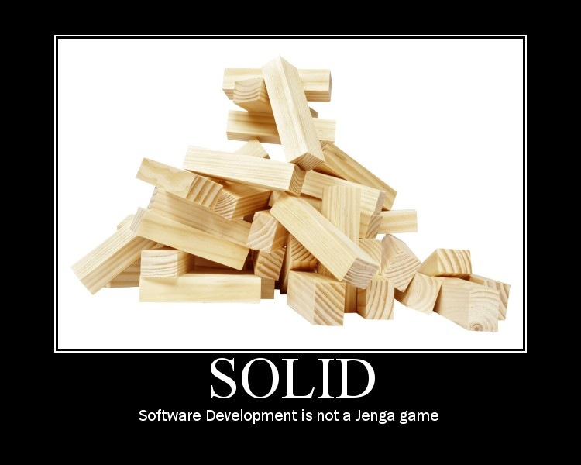

Slide 2
S.O.L.I.D. Software Development
Achieving Object Oriented Principles, One Step At A Time
Presented By:
Derick Bailey
Copyright 2008 McLane Advanced Technologies, LLC

Slide 3
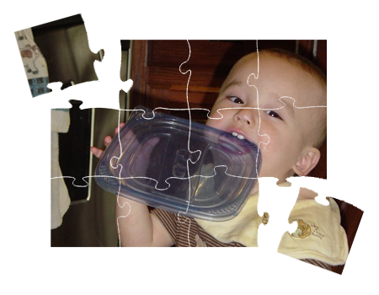
Object Oriented Principles
Cohesion:
“A measure of how strongly-related and focused the various responsibilities of a software module are” - Wikipedia

Slide 4
Object Oriented Principles
Coupling:
“The degree to which each program module relies on each one of the other modules” – Wikipedia

Slide 5
Object Oriented Principles
Encapsulation:
“The hiding of design decisions in a computer program that are most likely to change” - Wikipedia
?

Slide 6
S.O.L.I.D. Principles
SRP: Single Responsibility Principle
OCP: Open Closed Principle
LSP: Liskov Substitution Principle
ISP: Interface Segregation Principle
DIP: Dependency Inversion Principle

Slide 7

SRP: Single Responsibility Principle
One Responsibility – One Reason To Change

Slide 8
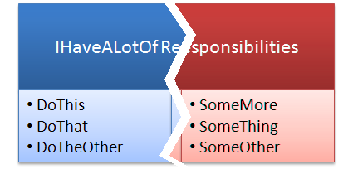
SRP: Single Responsibility
“If a class has more then one responsibility, then the responsibilities become coupled. Changes to one responsibility may impair or inhibit the class’ ability to meet the others. This kind of coupling leads to fragile designs that break in unexpected ways when changed.”
- Robert C. Martin

Slide 9
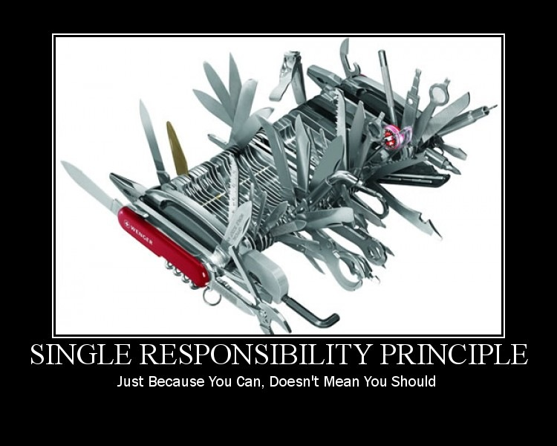

Slide 10
SRP: Single Responsibility
Example App: Read A Flat File And Send An Email
Email Sending App
File

Slide 11
SRP: Single Responsibility
Example App New Requirements:
Send From Non-WinForms App.
Read XML Or Flat File
Email Sending App
Email Sender
Flat File
XML File

Slide 12
SRP: Single Responsibility
Example App: A Better Structure
Email Sender
Format Reader
Flat File
XML File

Slide 13
OCP: Open Closed Principle
Open For Extension, Closed For Modification

Slide 14
OCP: Open Closed Principle
Modules that conform to the open-closed principle have two primary attributes.
They are “Open For Extension”. This means that the behavior of the module can be extended. That we can make the module behave in new and different ways as the requirements of the application change, or to meet the needs of new applications.
They are “Closed for Modification”. The source code of such a module is inviolate. No one is allowed to make source code changes to it.
- Robert C. Martin

Slide 15
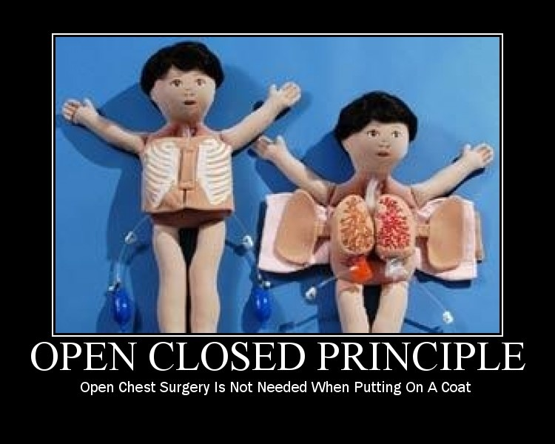

Slide 16
OCP: Open Closed Principle
Example App: Restructuring For OCP
FileReader
Service
Email Sender
IFileFormat Reader
Flat File
XML File

Slide 17
LSP: Liskov Substitution Principle
Derived Classes Must Be Semantically Substitutable For Their Base Classes.

Slide 18


LSP: Liskov Substitution Principle
“If for each object o1 of type S there is an object o2 of type T such that for all programs P defined in terms of T, the behavior of P is unchanged when o1 is substituted for o2 then S is a subtype of T.”
- Barbara Liskov
Square
!=
Rectangle
!=

Slide 19
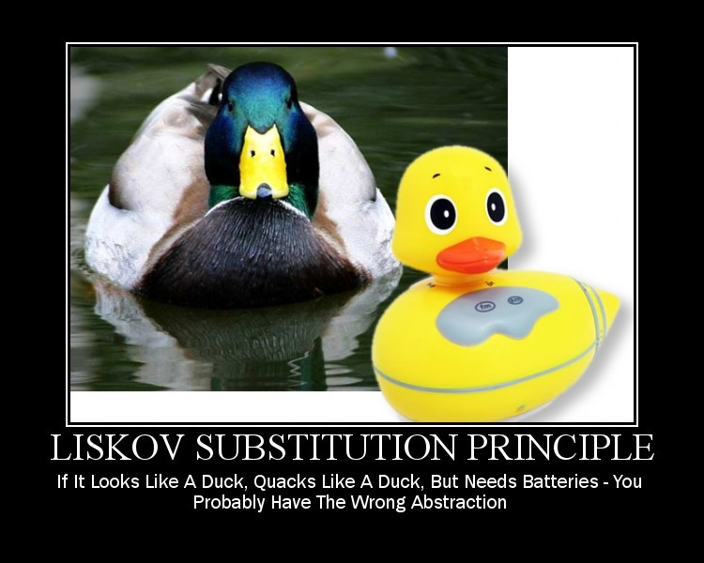

Slide 20
LSP: Liskov Substitution Principle
Example App: Violating LSP with Database Connection Info
Database
FileReader
Service
Email Sender
IFileFormat Reader
Flat File
XML File
Database Connection File

Slide 21
LSP: Liskov Substitution Principle
Example App: Correcting For LSP – Move The Database Reader
Database
Database
Reader
Service
Flat File
Email Sender
IFileFormat Reader
FileReader
Service
XML File

Slide 22
ISP: Interface Segregation Principle
A Client Should Not Depend On An Interface It Does Not Use

Slide 23
ISP: Interface Segregation Principle
“This principle deals with the disadvantages of ‘fat’ interfaces. Classes that have ‘fat’ interfaces are classes whose interfaces are not cohesive. In other words, the interfaces of the class can be broken up into groups of member functions. Each group serves a different set of clients. Thus some clients use one group of member functions, and other clients use the other groups.”
- Robert Martin

Slide 24
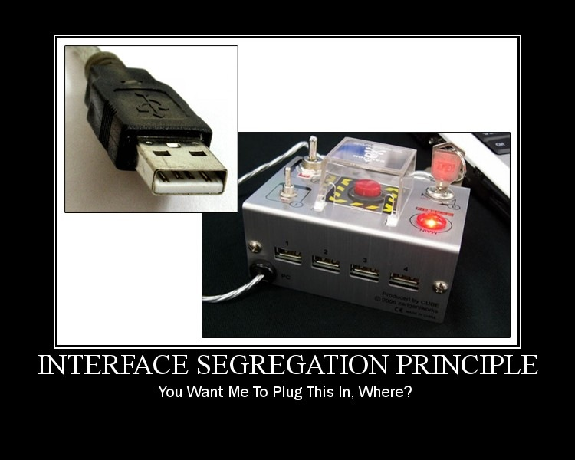

Slide 25
ISP: Interface Segregation Principle
Example App: Clarifying The Email Sender and Message Info Parsing
EmailSender
EmailSender
Database Reader
Service
SendEmail
ReadFile
ReadFromDb
SendEmail
GetMessageBody
FileReader
Service
GetMessageBody

Slide 26
DIP: Dependency Inversion Principle
Depend On Abstractions, Not Concrete Details And Implementations

Slide 27
DIP: Dependency Inversion Principle
“What is it that makes a design rigid, fragile and immobile? It is the interdependence of the modules within that design. A design is rigid if it cannot be easily changed. Such rigidity is due to the fact that a single change to heavily interdependent software begins a cascade of changes in dependent modules.”
- Robert Martin
Dependency
Depender

Slide 28
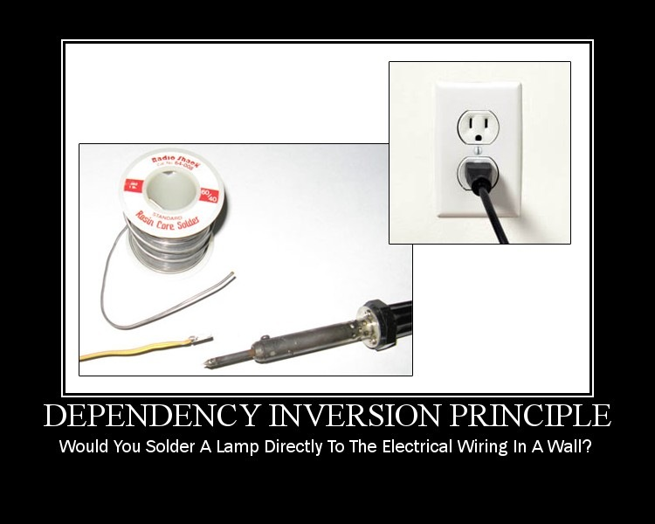

Slide 29
DIP: Dependency Inversion Principle
ThisClass
ThatClass
AnotherClass

Slide 30
DIP: Dependency Inversion Principle
IDoSomething
ThisClass
IWhatever
ThatClass
AnotherClass

Slide 31
DIP: Dependency Inversion Principle
IDoSomething
IWhatever
ThisClass
ThatClass
IDoSomething
AnotherClass
IWhatever

Slide 32
DIP: Dependency Inversion Principle
AnotherClass
IWhatever
IWhatever
ThatClass
IDoSomething
IDoSomething
ThisClass

Slide 33
DIP: Dependency Inversion Principle
Example App: Constructor Dependencies in a Processing Service
Xml File Reader
Flat File Reader
IFileFormat Reader
Database Reader Service
File Reader Service
Email Sender
IMessageInfoRetriever
IEmailService
ProcessingService

Slide 34
Summarizing Our S.O.L.I.D. Conversion
Compare And Contrast The Original Code To The New Code

Slide 35
S.O.L.I.D. Conversion Summary
Example App: Before And After
IMessageInfo
Retriever
IEmailSender
Email Sending App
EmailProcessingService
Flat File
Database
Database
Reader
Service
IMessage
Info
Retriever
File
XML File
IFileFormat Reader
FileReader
Service
EmailService
IEmail
Service
Before
After

Slide 36
S.O.L.I.D. -> OO Principles
Low Coupling: OCP, DIP, ISP
IMessageInfo
Retriever
IEmailSender
EmailProcessingService
Flat File
Database
Database
Reader
Service
IMessage
Info
Retriever
XML File
IFileFormat Reader
FileReader
Service
EmailService
IEmail
Service

Slide 37
S.O.L.I.D. -> OO Principles
High Cohesion: Low Coupling + SRP, LSP
IMessageInfo
Retriever
IEmailSender
EmailProcessingService
Flat File
Database
Database
Reader
Service
IMessage
Info
Retriever
XML File
IFileFormat Reader
FileReader
Service
EmailService
IEmail
Service

Slide 38
S.O.L.I.D. -> OO Principles
Encapsulation: SRP, LSP, DIP
IMessageInfo
Retriever
IEmailSender
EmailProcessingService
Flat File
Database
Database
Reader
Service
IMessage
Info
Retriever
XML File
IFileFormat Reader
FileReader
Service
EmailService
IEmail
Service

Slide 39
Additional Resources
Uncle Bob’s Principle Of Object Oriented Development:
http://butunclebob.com/ArticleS.UncleBob.PrinciplesOfOod
Pablo’s Topic Of The Month: SOLID
http://www.lostechies.com/blogs/chad_myers/archive/2008/03/07/pablo-s-topic-of-the-month-march-solid-principles.aspx
Agile Principles, Patterns, And Practices In C#
by Robert (Uncle Bob) Martin and Micah Martin

Slide 40
About Me… Derick Bailey
Sr. Software Engineer and Architect @ McLane Advanced Technologies
Personal Blog, Etc: derickbailey.com derickbailey.lostechies.com
Email: derick.bailey@mclaneat.com derick@derickbailey.com
Twitter: @derickbailey
www.mclaneat.com
McLane Advanced Technologies
4001 Central Pointe Parkway
Temple, Texas 76504
800-988-5428
Copyright 2008 McLane Advanced Technologies, LLC

